Slide 1
NHS 2025 CONFERENCE
Scaling Impact: Primary Health Care-Based Hypertension Control in NHCI States (Kano and Ogun), Nigeria – A Model for National Scale Upp
June 24, 2025

Slide 2
Content
01
Background
02
Methodology
Conclusion
04
03
Results

Slide 3
Brief Background of the NHCI Program
Hypertension is a major public health concern in Nigeria, leading to significant morbidity and mortality. Despite existing efforts, many people remain unaware of their condition, and treatment and control rates are suboptimal.
AIM
Project HOPE aims to address these challenges through a comprehensive program in Kano and Ogun states. The project will focus on improving blood pressure control, reducing client drop-out, and strengthening program sustainability.
DONOR: Resolve to Save Lives
Key interventions include:
Strengthening stakeholder engagement
Building capacity
Improving data quality
Sokoto
Kastina
Yobe
Borono
Zamfara
Kebbi
Jigawa
Kano
Bauchi
Through these efforts, Project HOPE seeks to:
Niger
Kaduna
Gombe
Plateau
Adamawa
Increase awareness of hypertension and its risks.
Kwars
Nassarawa
Taraba
Oyo
Abuja
Improve access to screening, diagnosis, and treatment services.
Kogi
Benue
Osun
Ekiti
Ogun
Ondo
Edo
Enugu
Enhance adherence to treatment regimens.
Cross
River
Lagos
Delta
Anambara
Ebonyi
Imo
Abia
Bayelsa
Rivers
Akwa
Ibom
Strengthen the capacity of healthcare providers to deliver effective care.

Slide 4
Funder: Resolve To Save Lives
Partners: Implementers – WHO, FMOH, NPHCDA, Kano and Ogun state MOH and SPHCDB
Duration: The Project is in it’s 3rd Year
Target Area: Kano and Ogun state respectively
Beneficiaries: Individuals 18yrs and above who are hypertensive
Coverage: 52 facilities across in 22 LGAs in Kano State and 236 PHCs across 20 LGAs in Ogun State. Of these, 52 received initial project support, while the remaining 184 were activated by the state.
Project Duration
YEAR 1
1st Feb 2023 – 31st January 2024
YEAR 2
1st Feb 2024 – 31st January 2025
YEAR 3
1st Feb 2025 – 31st January 2026

Slide 5
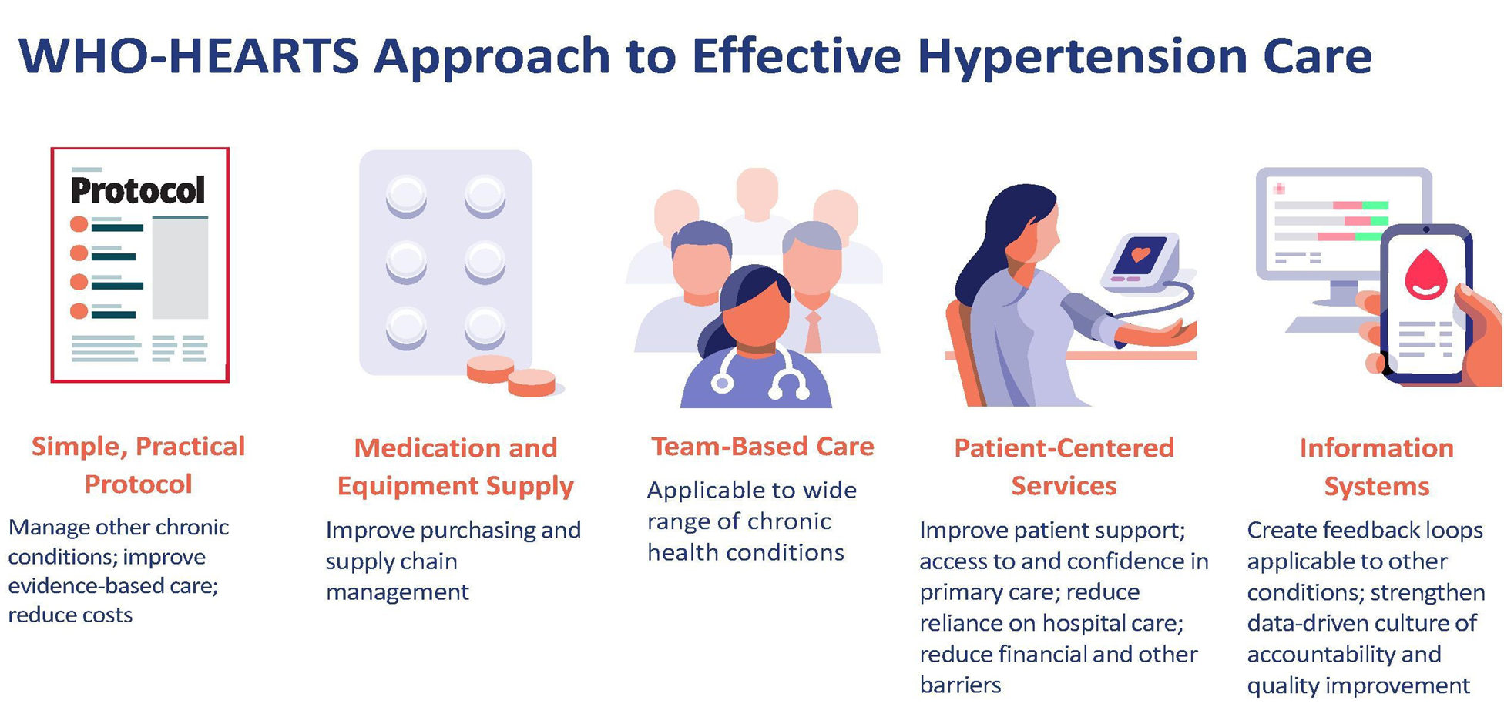
Methodology

Slide 6
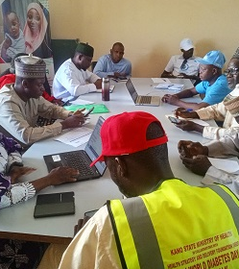
Implementation Strategies
Training of healthcare workers on comprehensive hypertension diagnosis, care and treatment
Use of a simplified treatment protocol to guide service delivery at PHC
Ensure availability of medications, and basic equipment at all times when needed at the facility
Team-based and Patient centered care, tracking and follow-up systems
Routine and regular supportive supervision and mentoring to reinforce and enhance knowledge and skills of HCWs.
Regular audit of documentation and information systems at facilities to provide data for informed decision making
Improved access to medication through enrolment of over 5,398 clients on health insurance
Improved programme ownership through strategic stakeholder engagement

Slide 7
NHCI Cascade as at May 2025

Slide 8
% Controlled BP at latest visit in past 3 months as at May 2025

Slide 9
Conclusion
The NHCI model has shown that effective hypertension control is achievable at scale through Nigeria’s primary health care (PHC) system. By integrating standardized protocols, task-sharing, and patient-centered delivery, the initiative strengthens PHC services and brings life-saving care closer to the people.
This model is:
Feasible – Built on existing health infrastructure and workforce.
Scalable – Adaptable for national rollout with minimal disruption.
Sustainable – Aligned with government priorities and UHC objectives. NHCI offers a proven blueprint for integrating noncommunicable disease care into PHCs—supporting Nigeria’s commitment to Universal Health Coverage and ensuring no one is left behind.

Slide 10
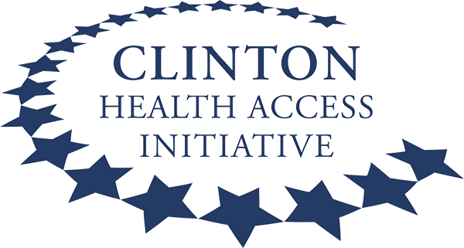
Partners

Slide 11
Costa Atori Ag. Country Representative catori@projecthope.org | +2348032411662
Thank You

